Slide 1
Can we predict the category of an app from it’s description?
By Vicente Echeveste & Anthony Tapias

Slide 2
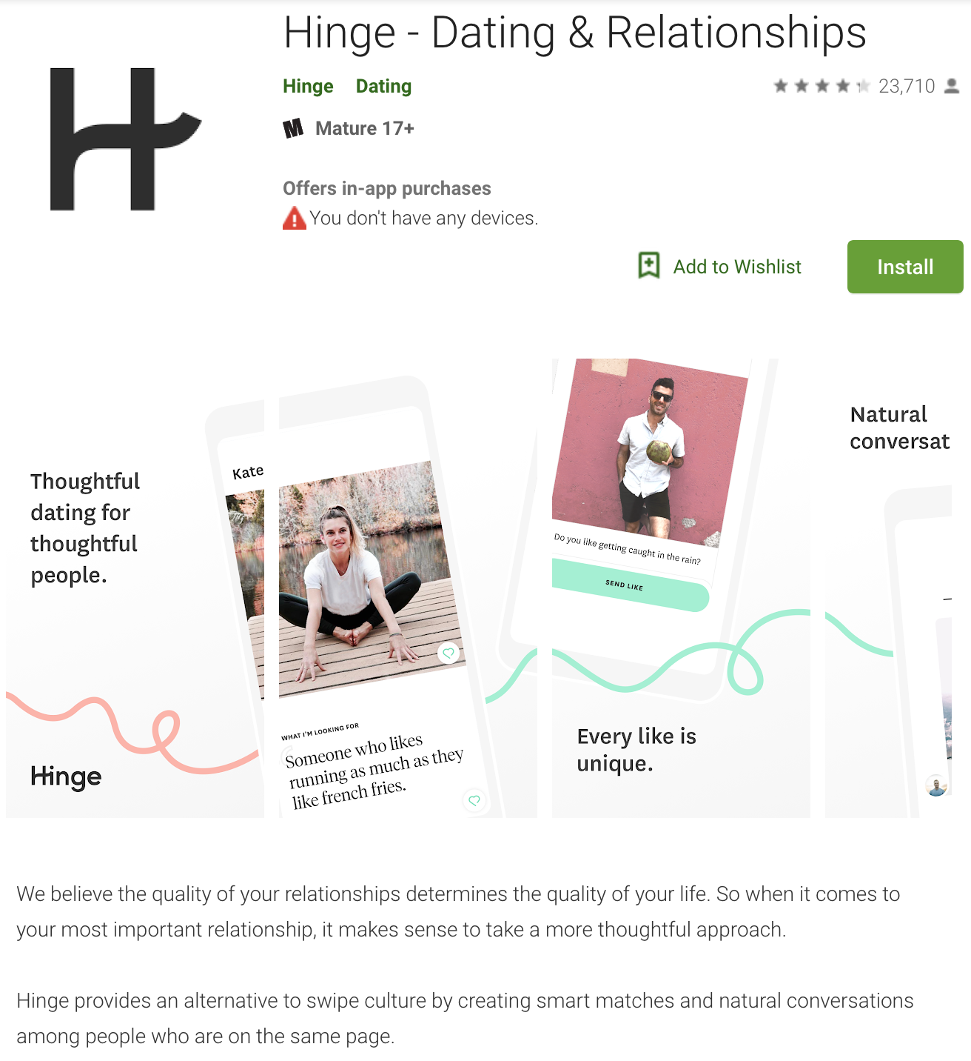
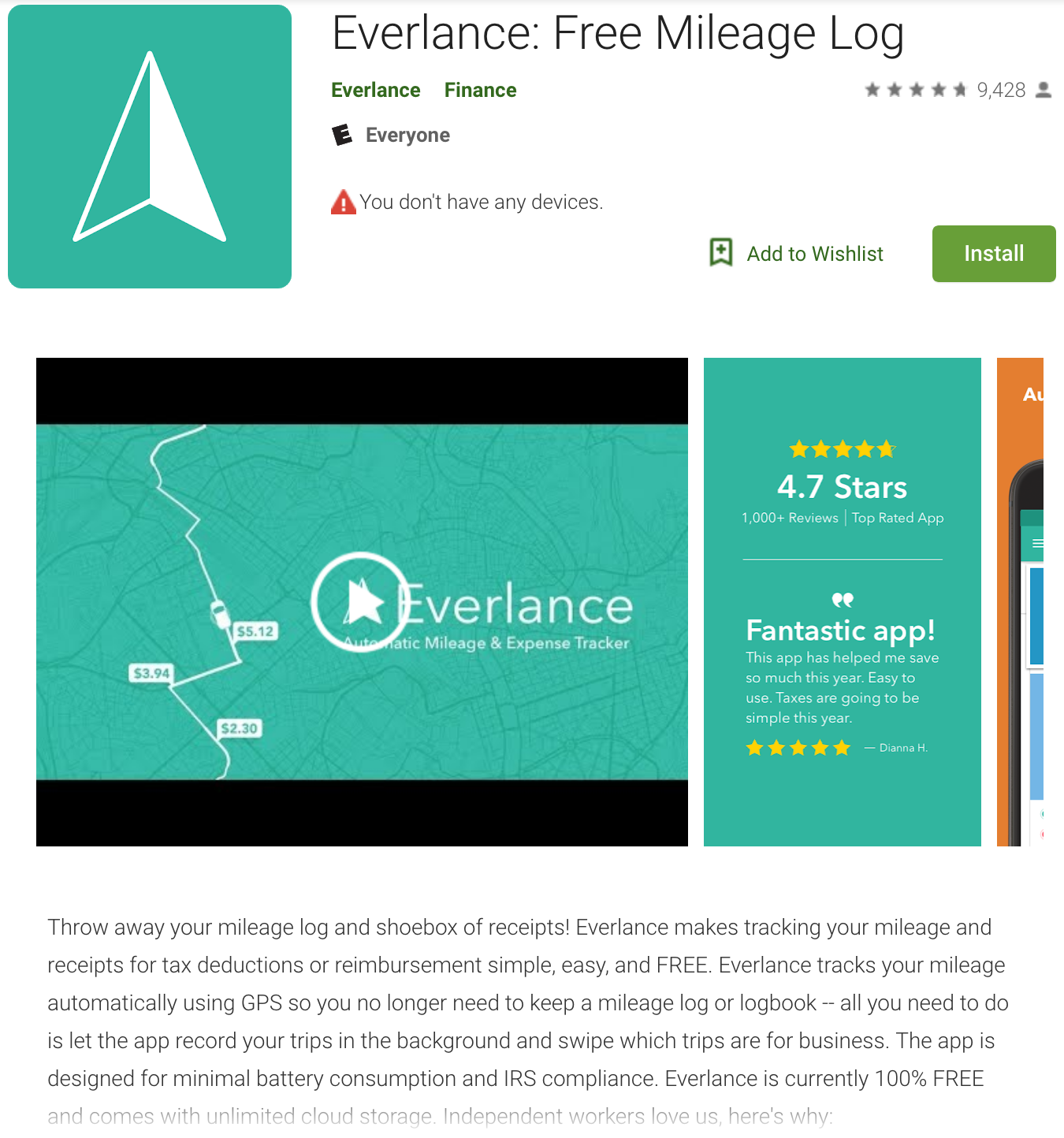
Predicting an App’s Category
We wanted to see if we can create a Machine Learning model that will accurately predict the category of an app from the app's description. To do this we created a web scraper to scrape data from the GooglePlay Store. After cleaning our data, we performed NLTK, Feature Engineering and Model Fitting to create an optimal ML Model.
Dating
Finance

Slide 3
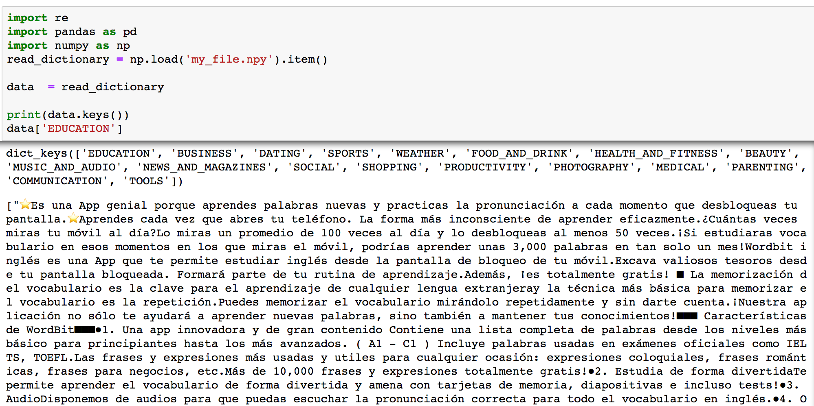
Web Scraper
We created a web scraper to collect 60 app descriptions per category for 18 categories. After collecting our data we saved it to a file in dictionary format.

Slide 4
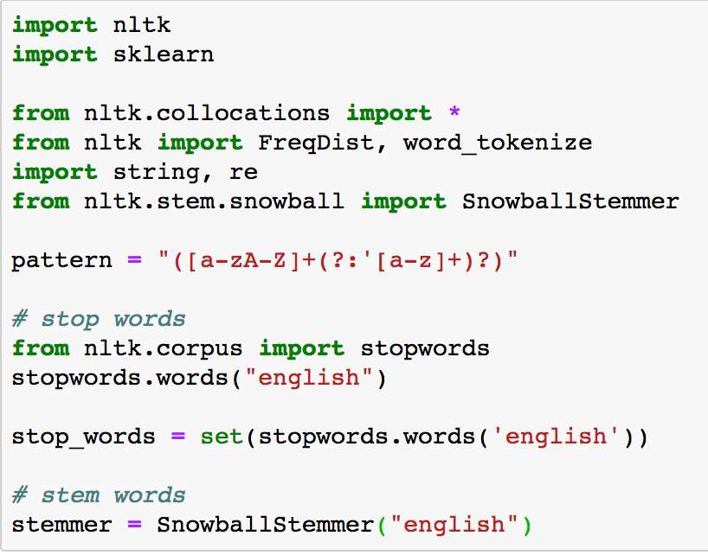
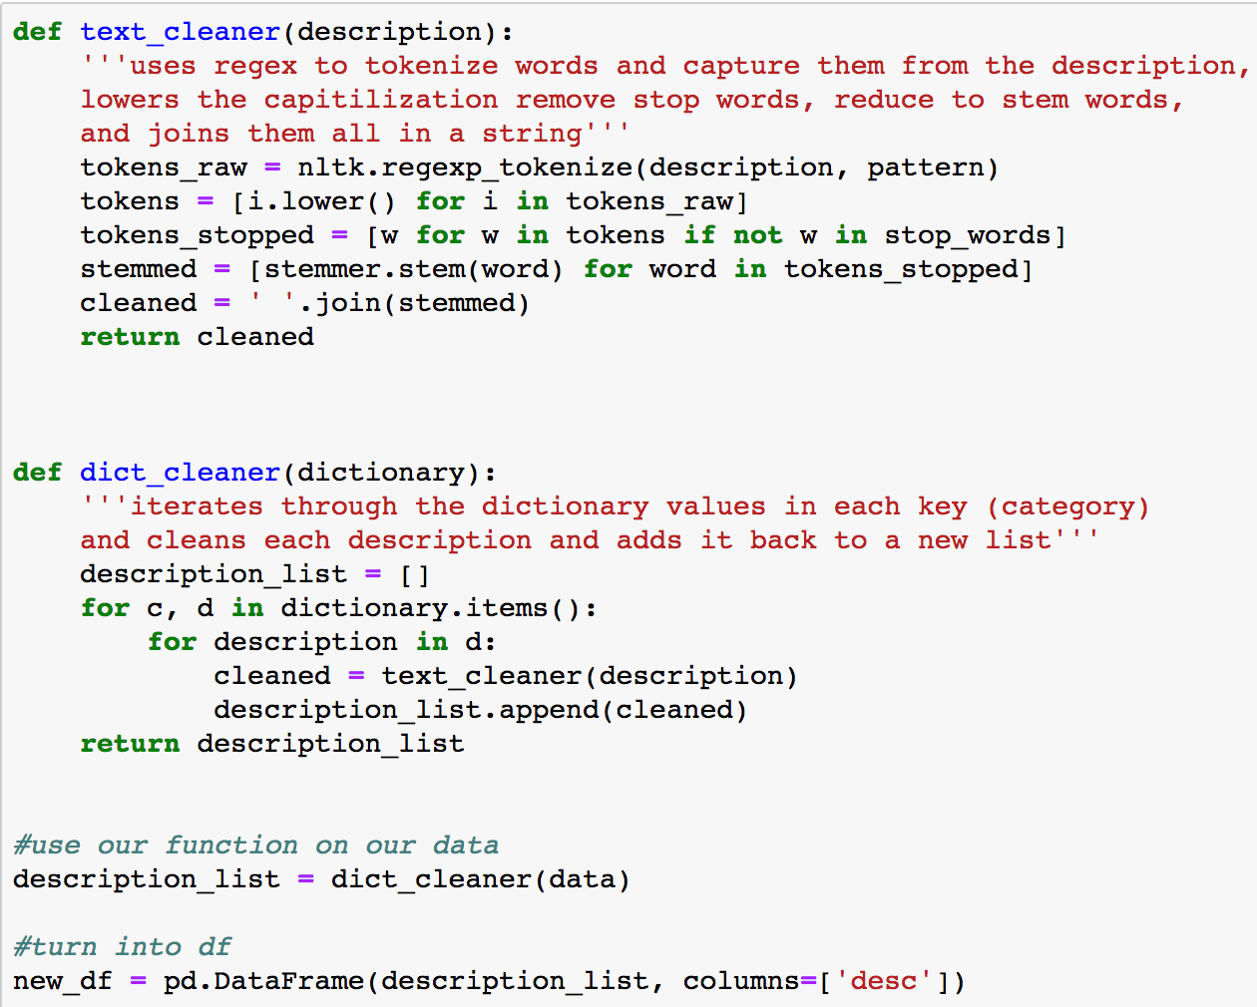
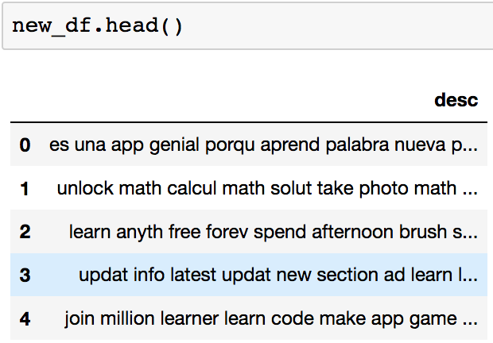
NLTK & Feature Engineering

Slide 5
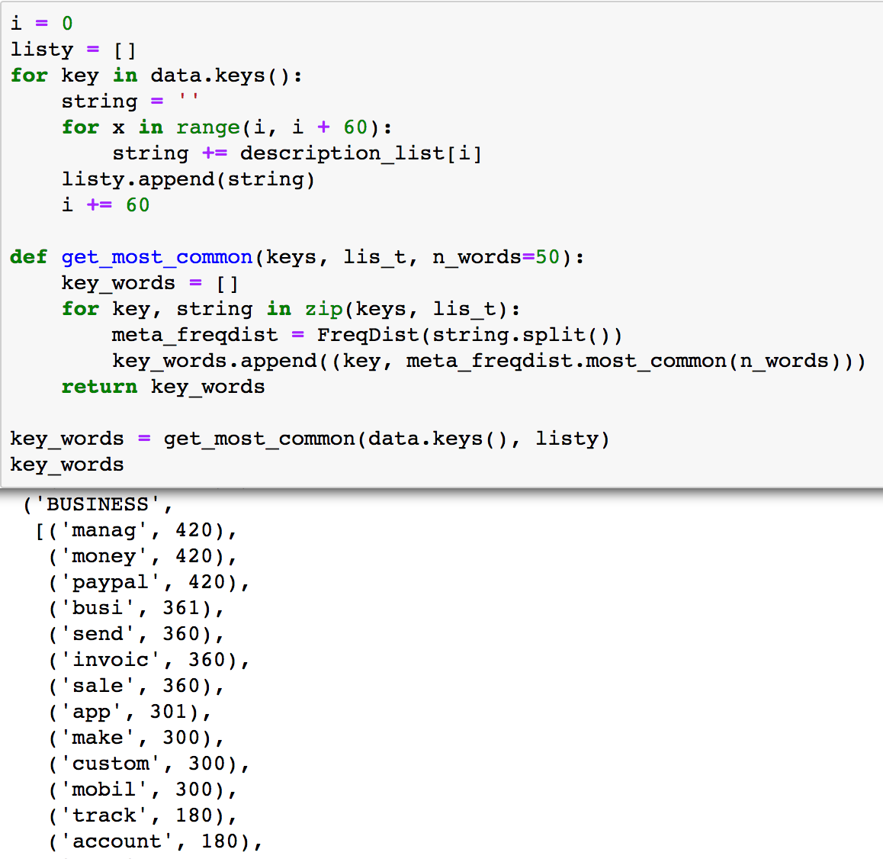
Frequency Distributions
Word count for each category

Slide 6
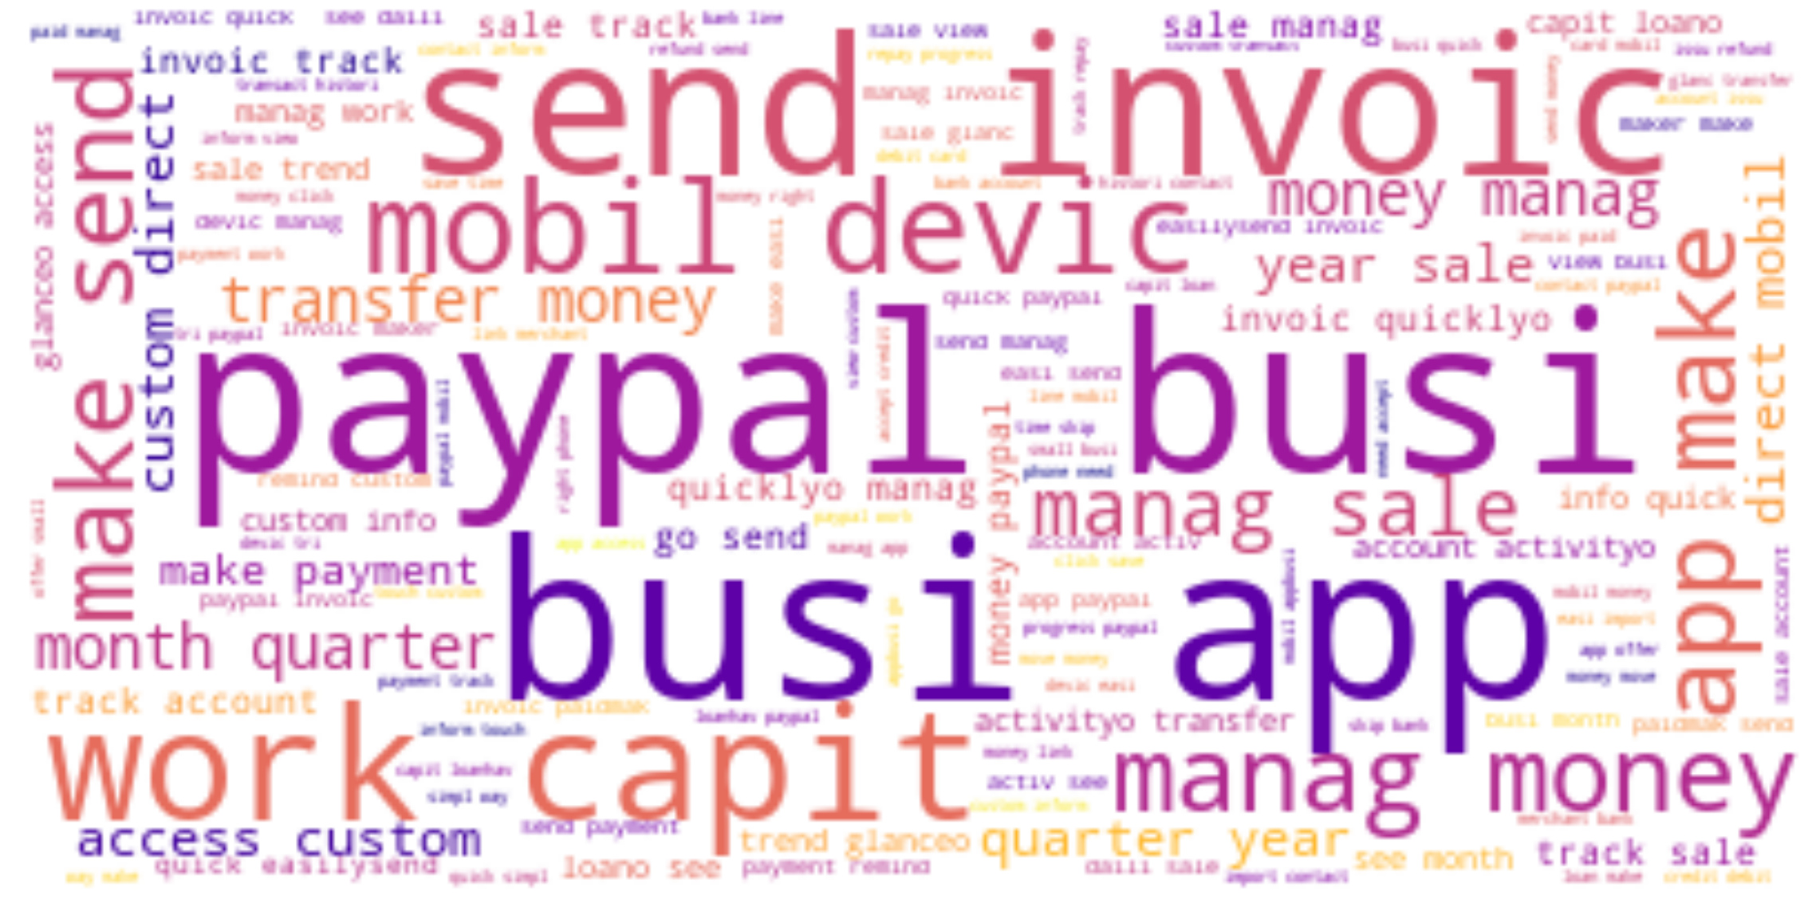
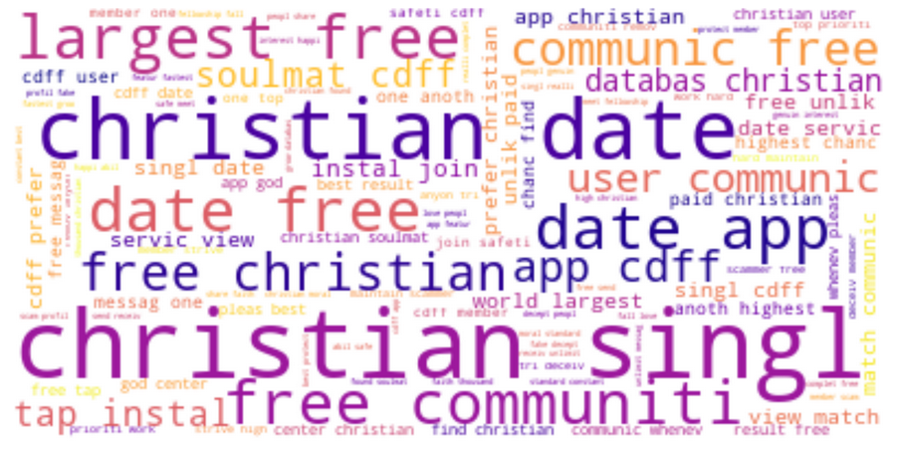
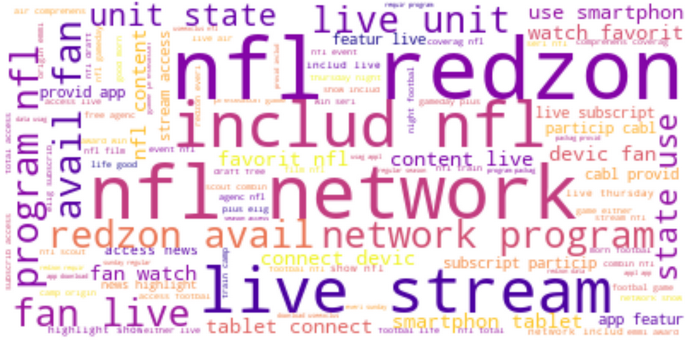
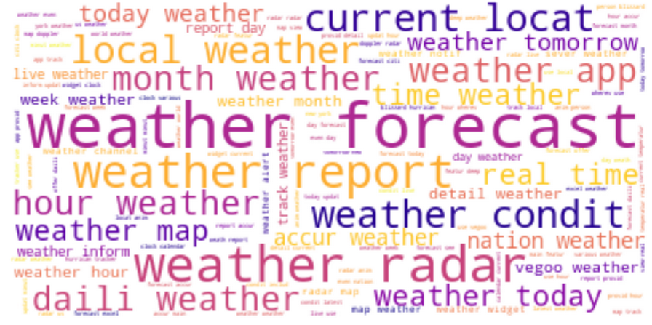
Business
Dating
Sports
Weather

Slide 7
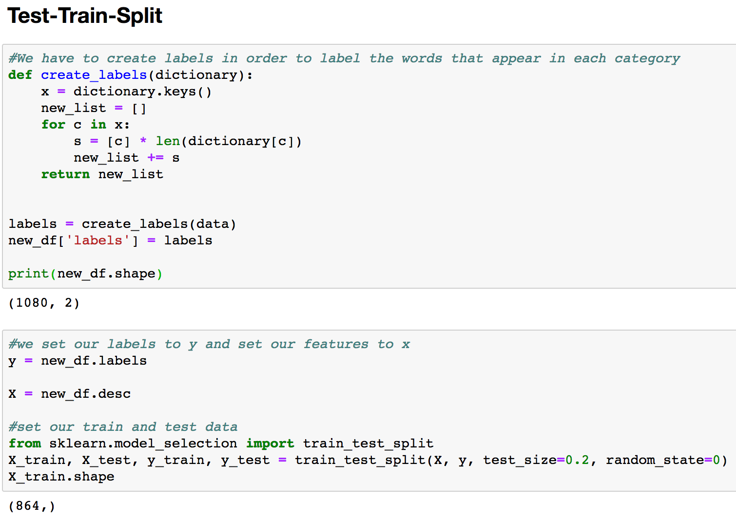
Test-Train-Split & TF-IDF

Slide 8
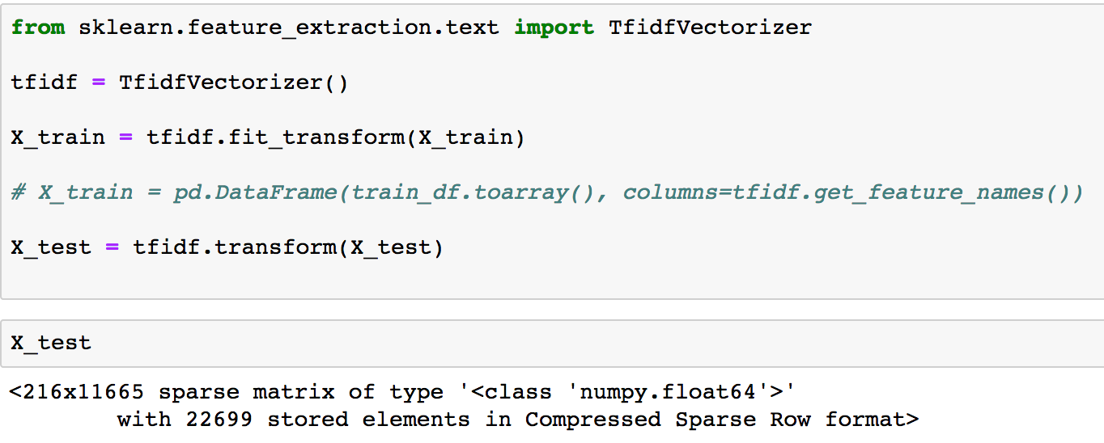
TD-IDF
We use TF-IDF function to transform our data to reflect how important a word is in the collection of descriptions in each category.

Slide 9
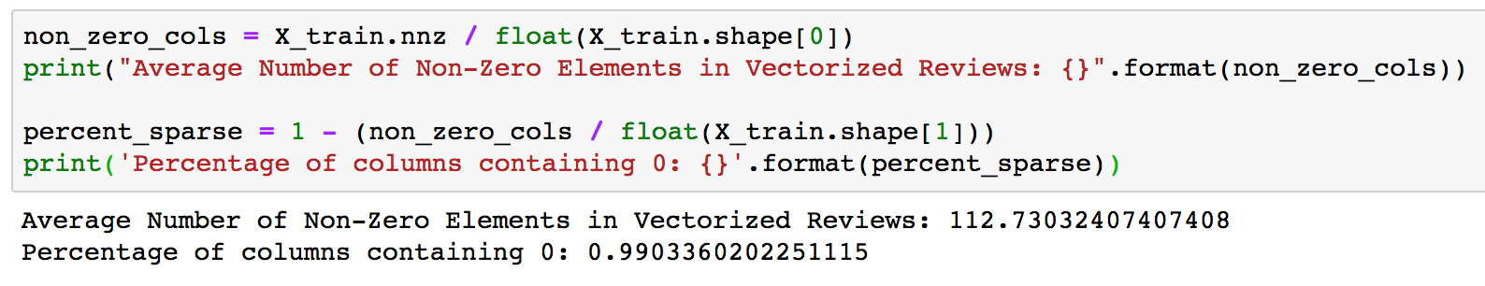
Corpus Statistics
How many non-zero elements are there?

Slide 10
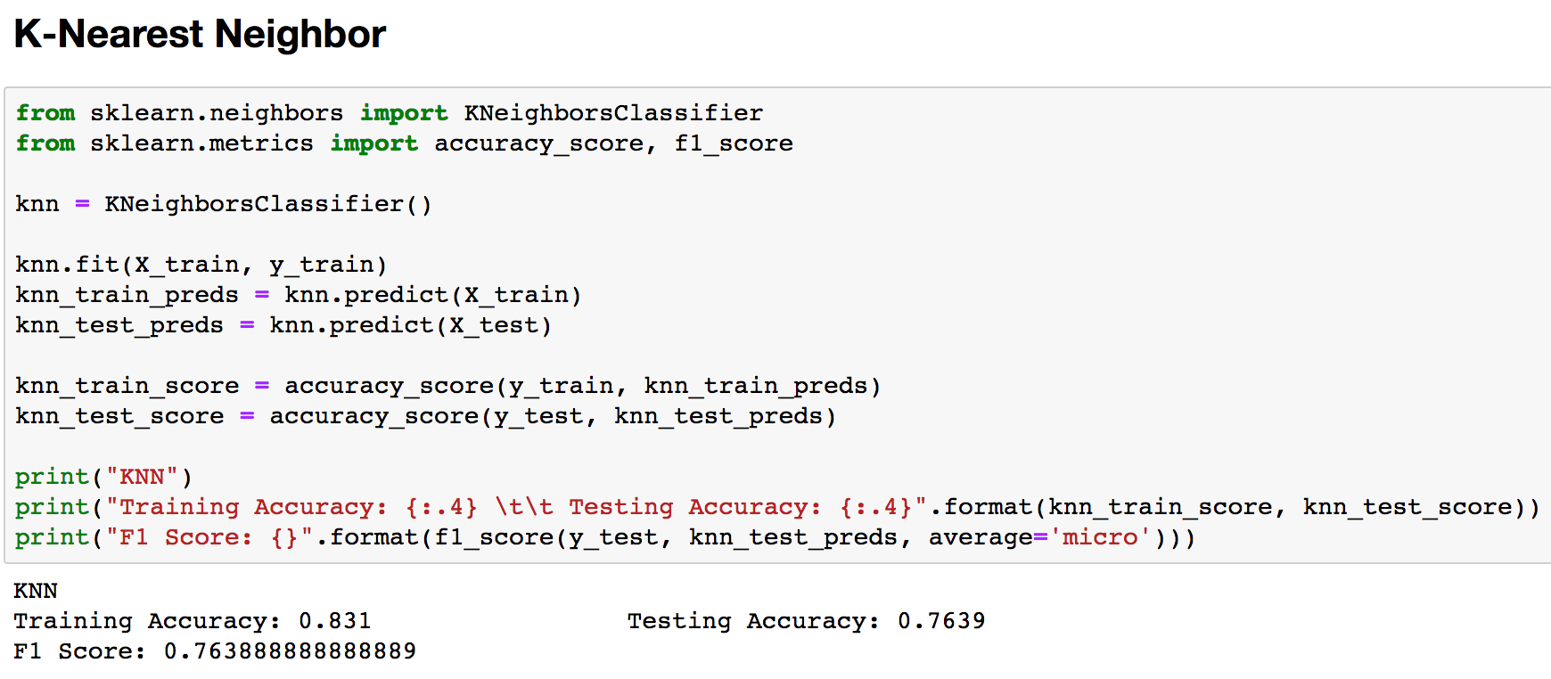
K-Nearest Neighbor

Slide 11
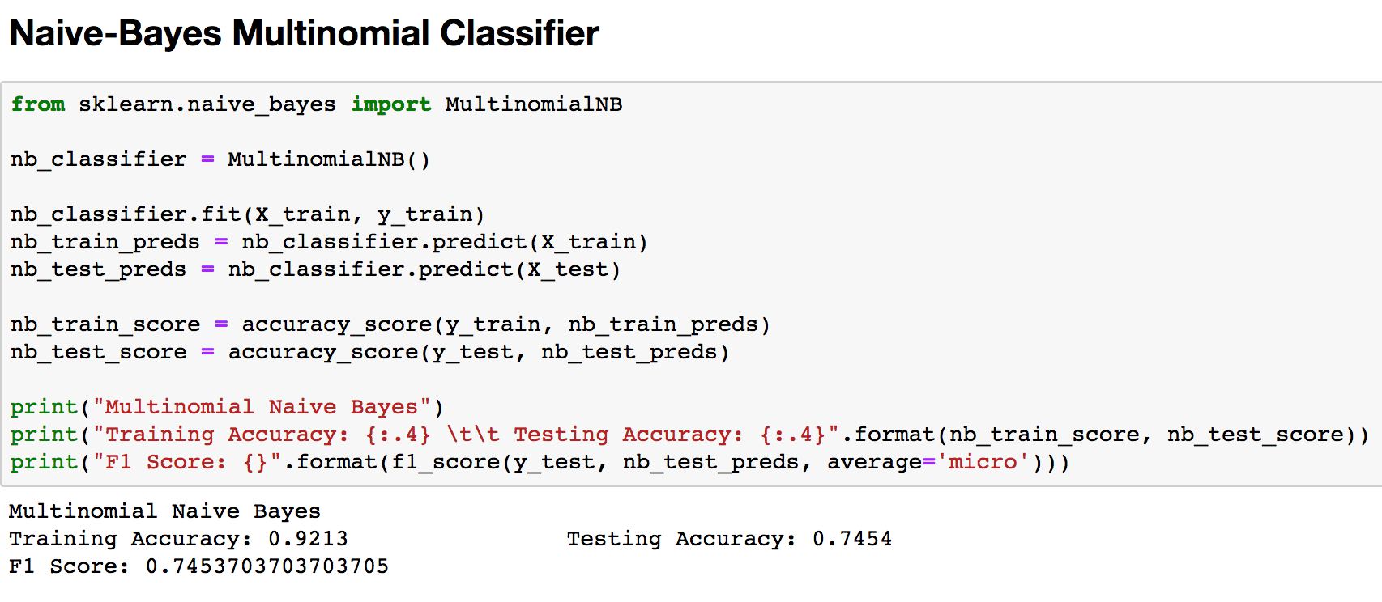
Naive-Bayes Multinomial Classifier

Slide 12
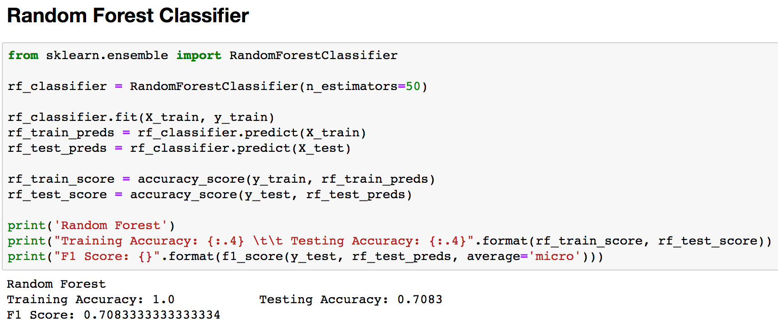
Random Forest Classifier

Slide 13
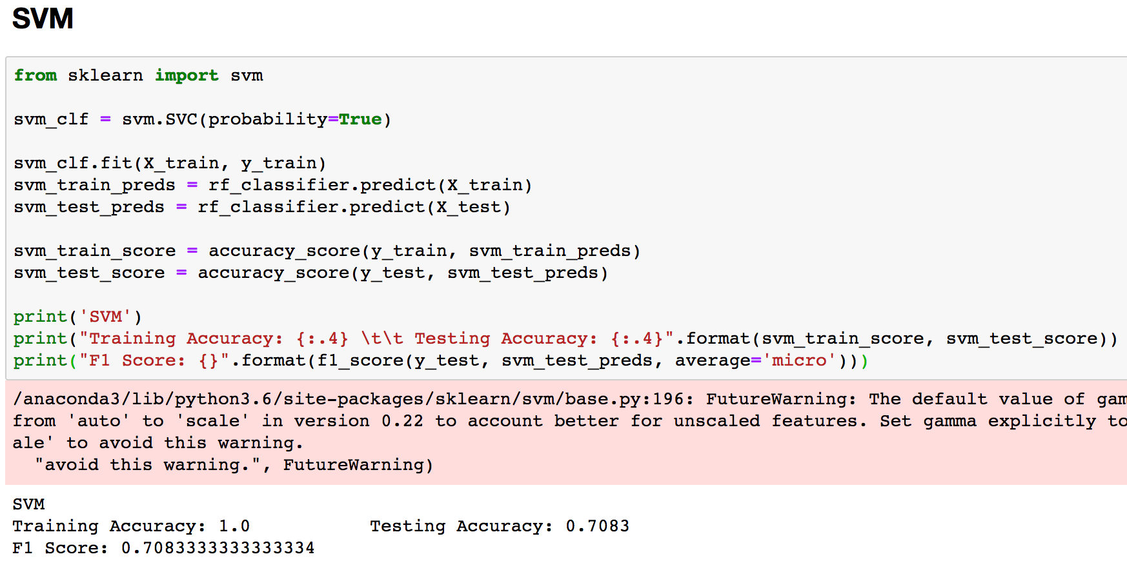
Support Vector Machine

Slide 14
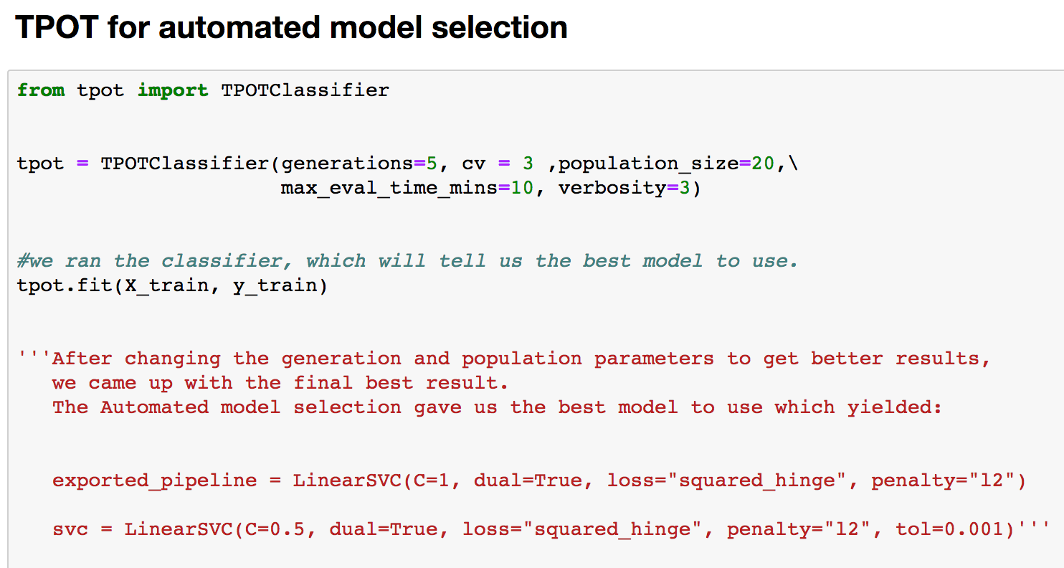
TPOT – Automated Model Selection

Slide 15
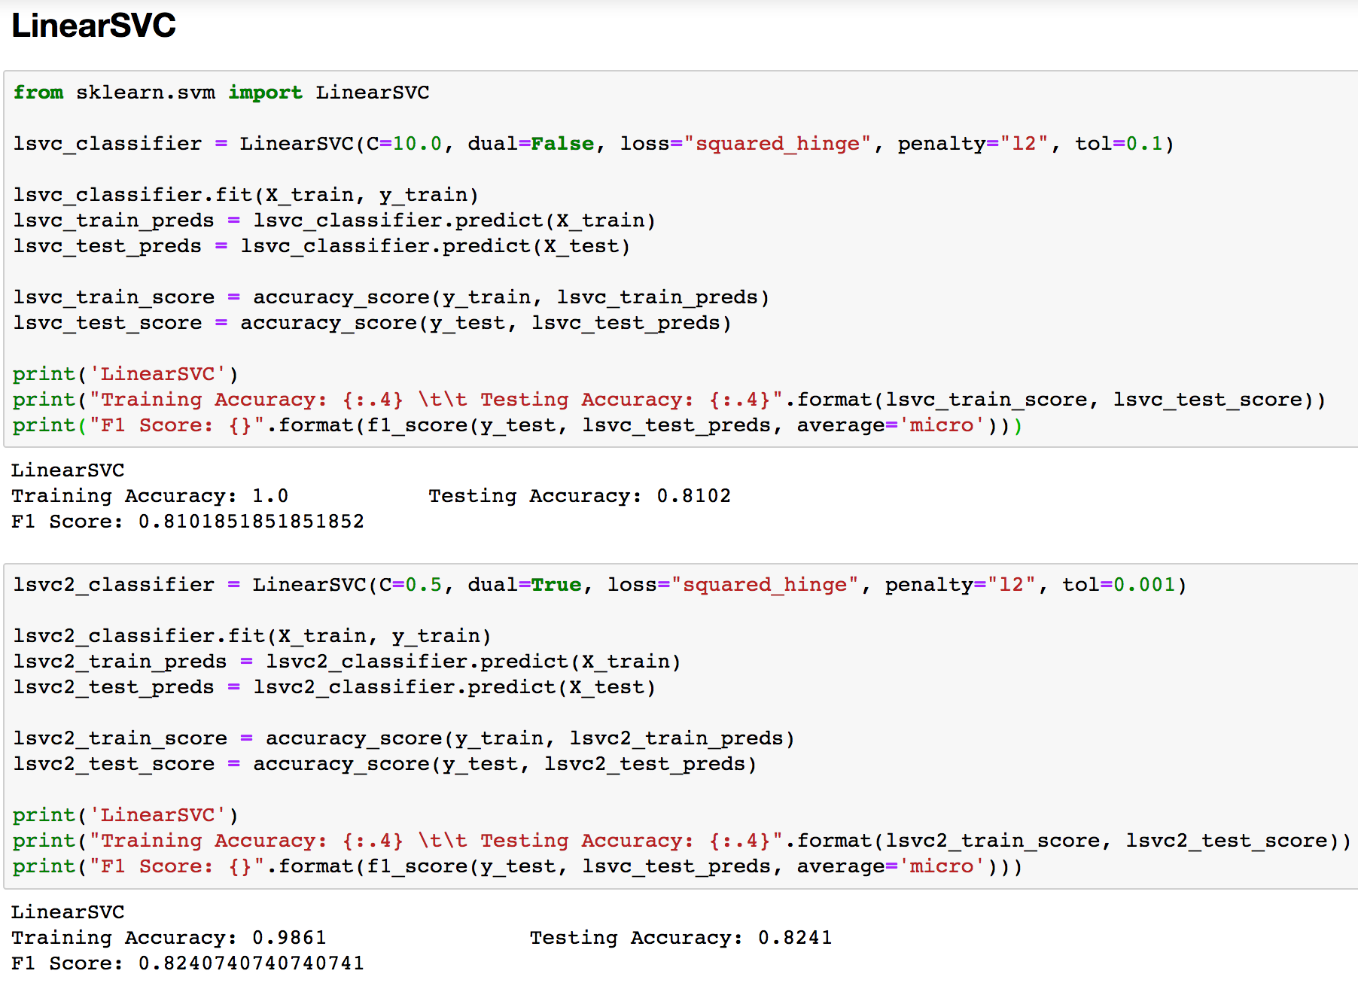
Linear SVC

Slide 16
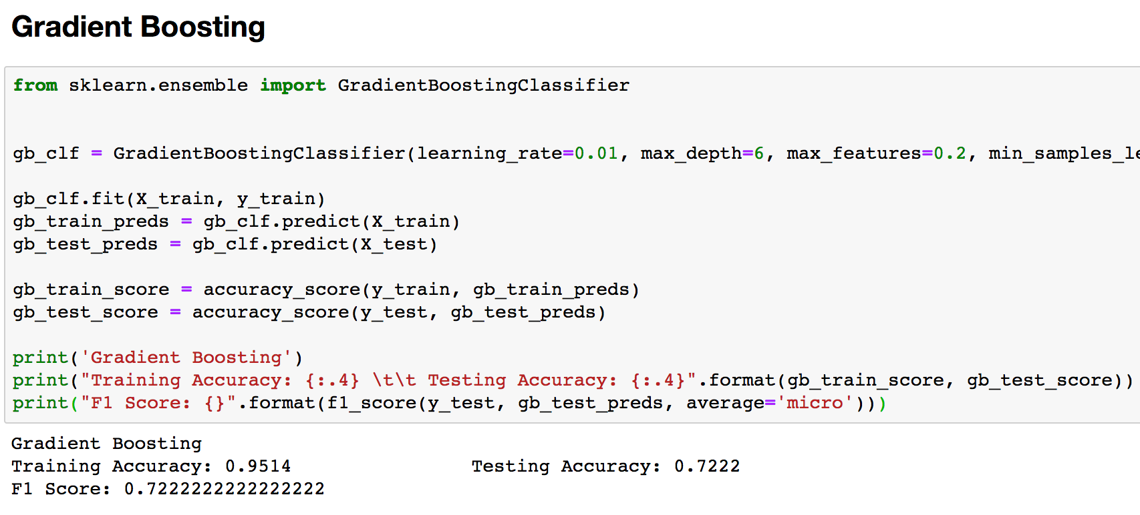
Gradient Boosing

Slide 17
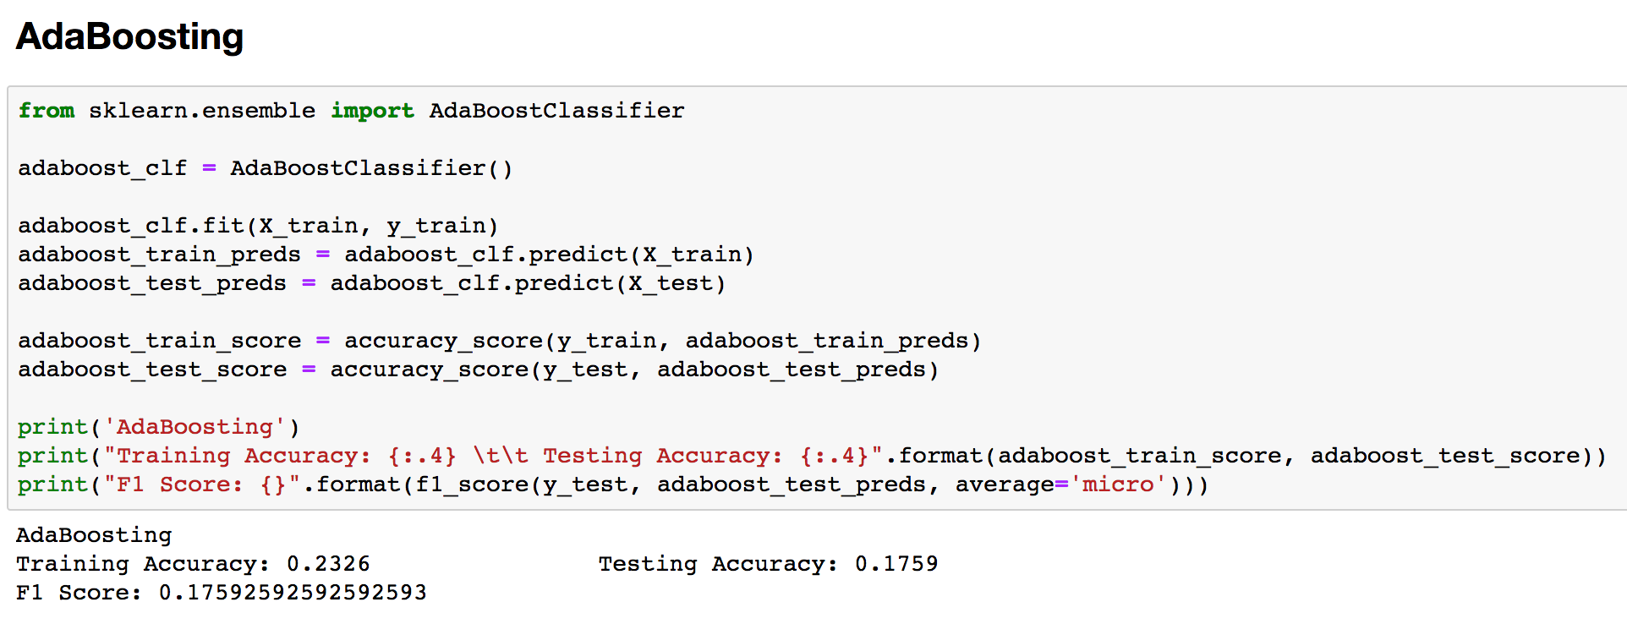
AdaBoosting

Slide 18
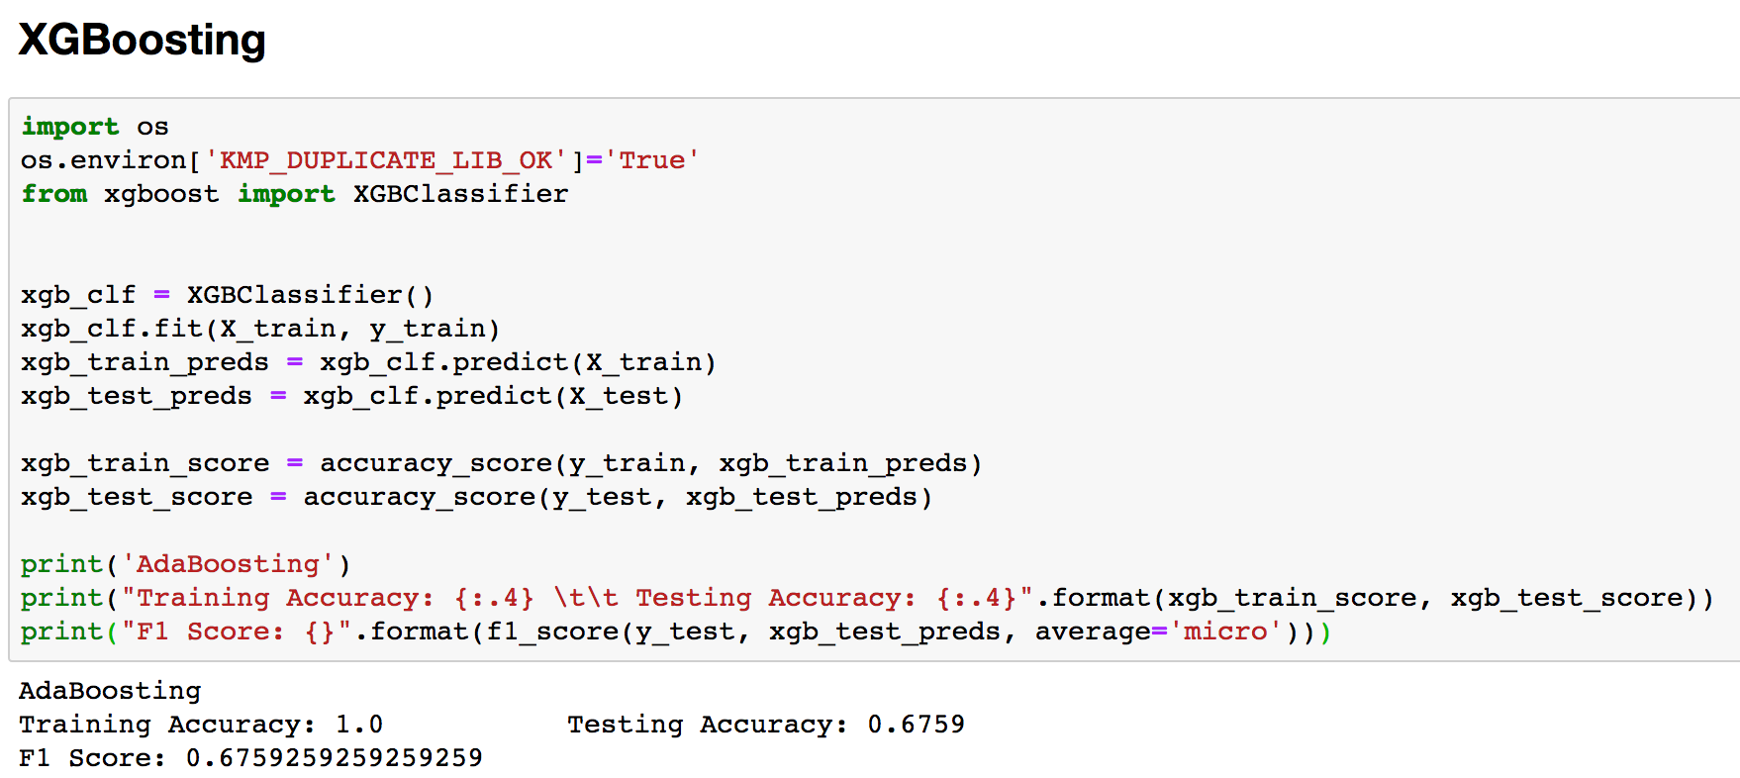
XGBoosting

Slide 19
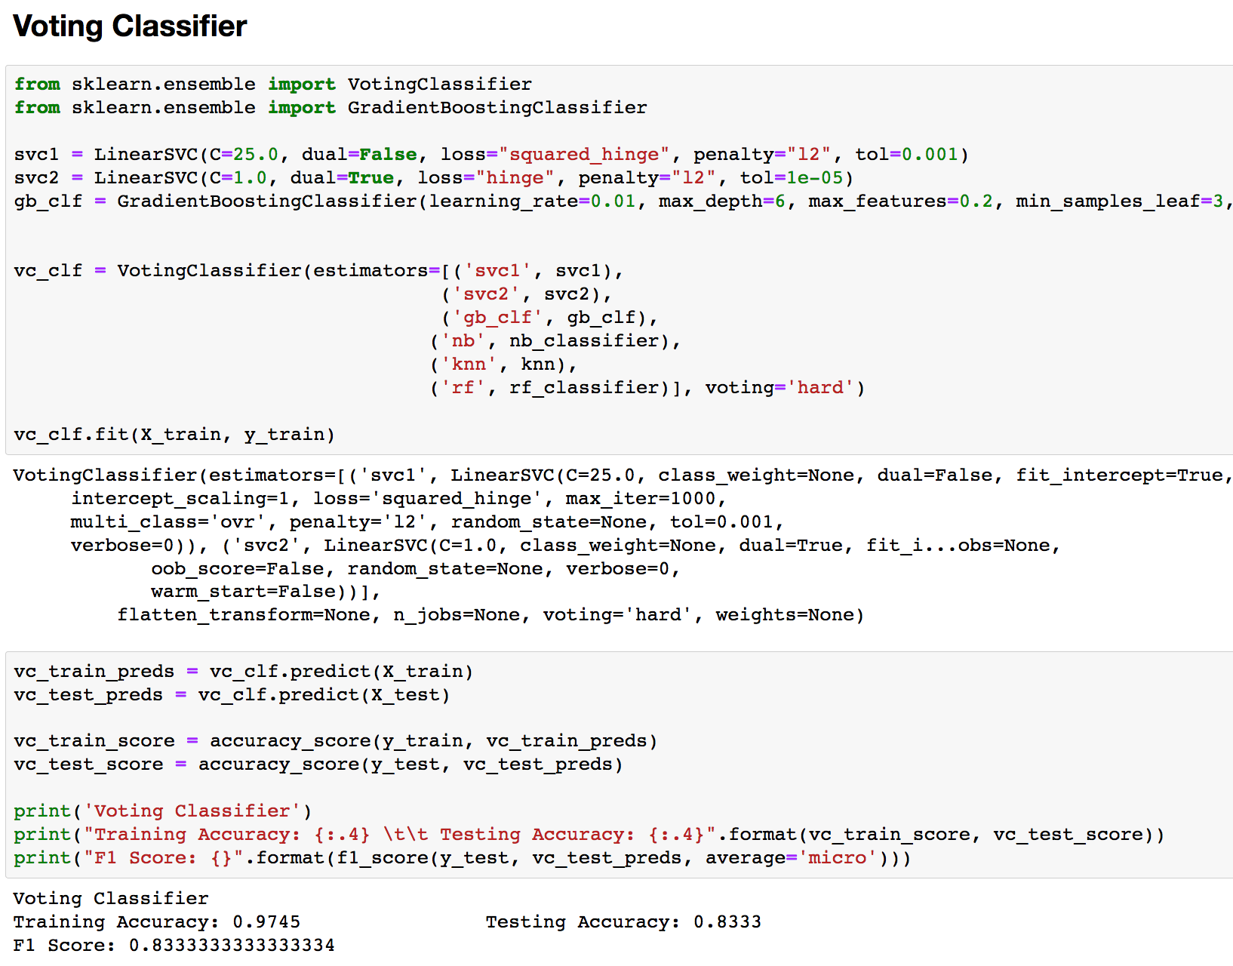
Voting Classifier

Slide 20
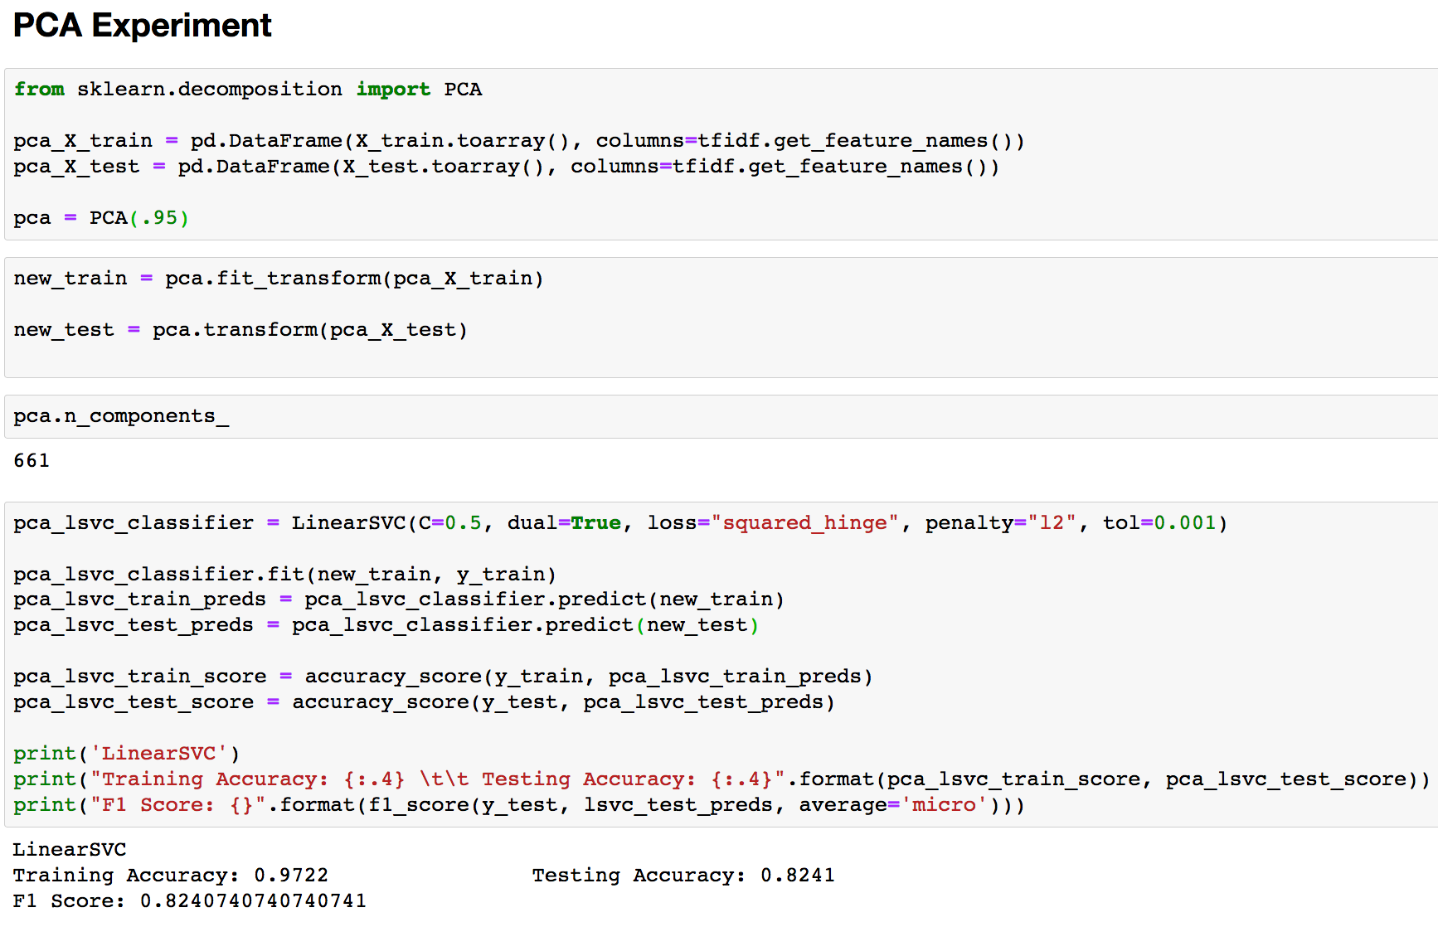
PCA with Linear SVC

Slide 21
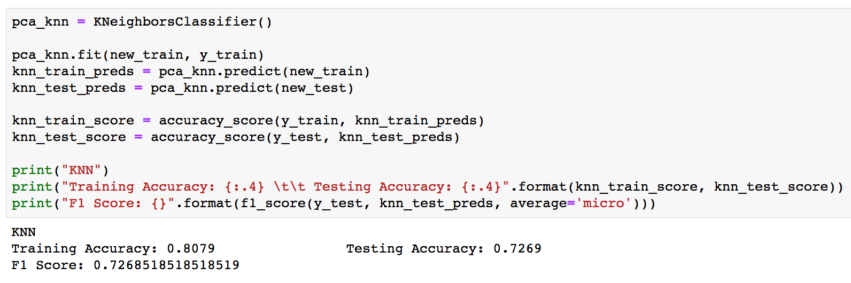
PCA with KNN

Slide 22
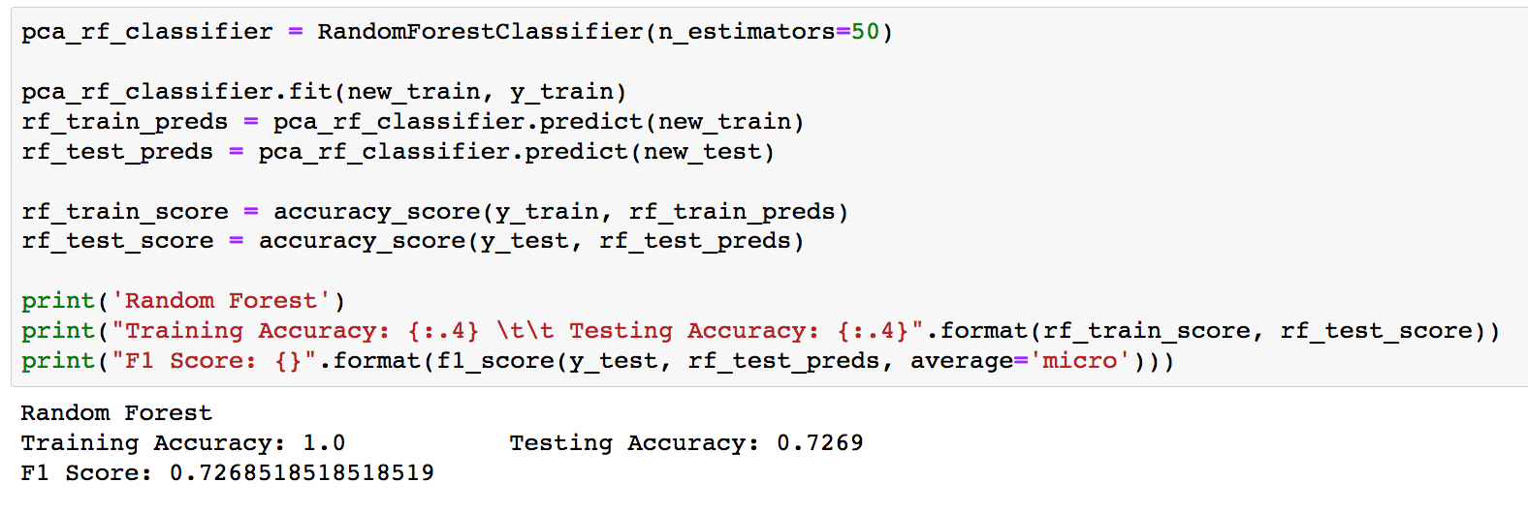
PCA with Random Forest
Naive Bayes did not work with PCA transformed data because it will not take in negative values.

Slide 23
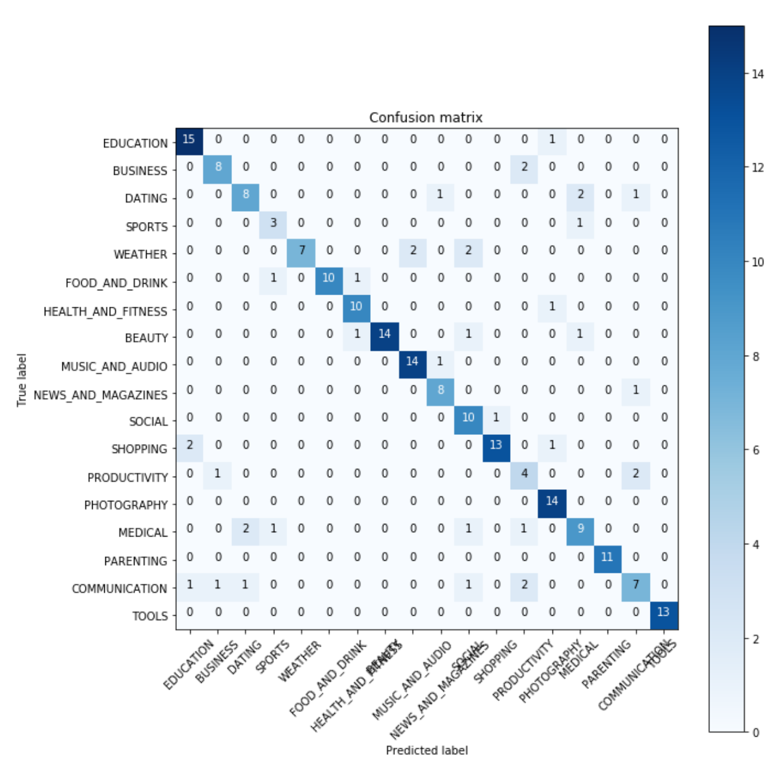
Visual Analysis: Confusion Matrix

Slide 24
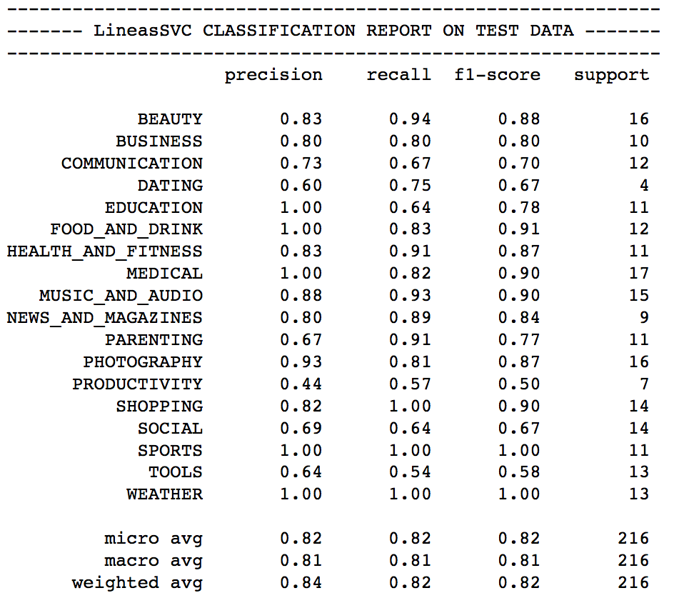
Classification Report on Test Data

Slide 25
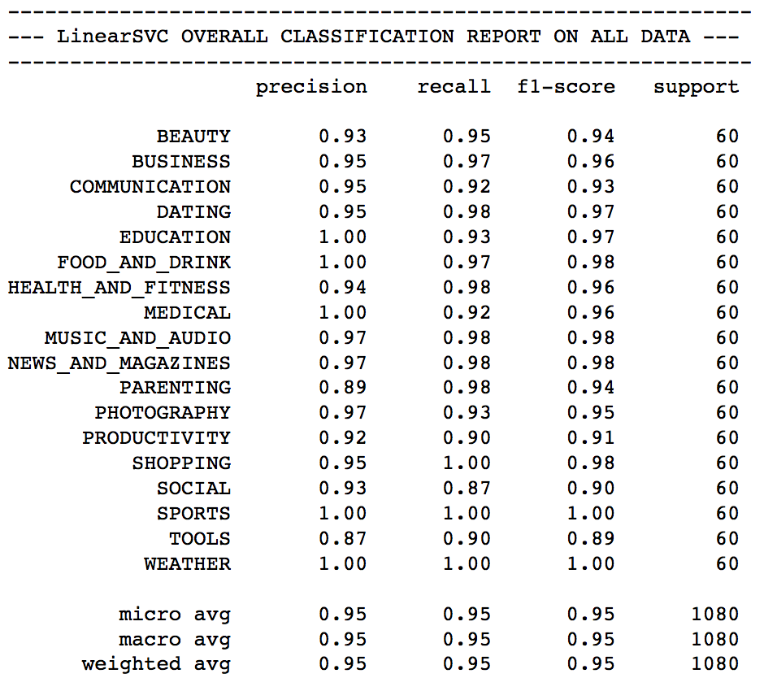
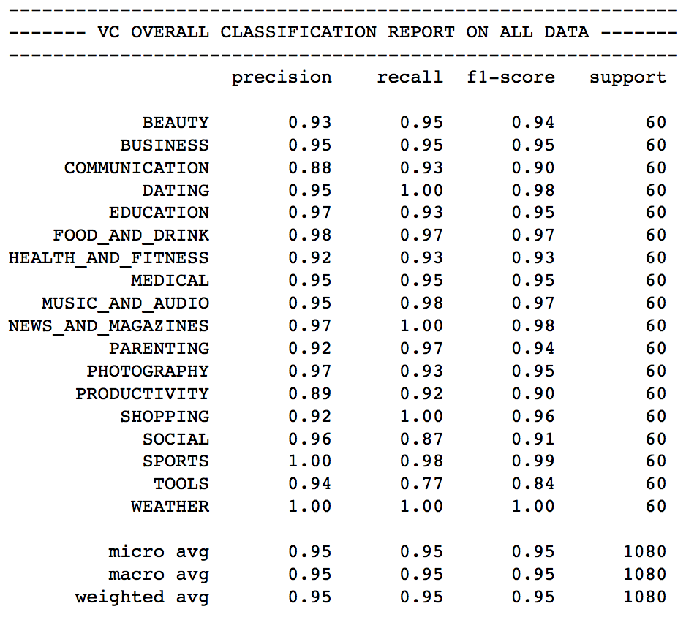
Classification Report on All Data

Slide 26
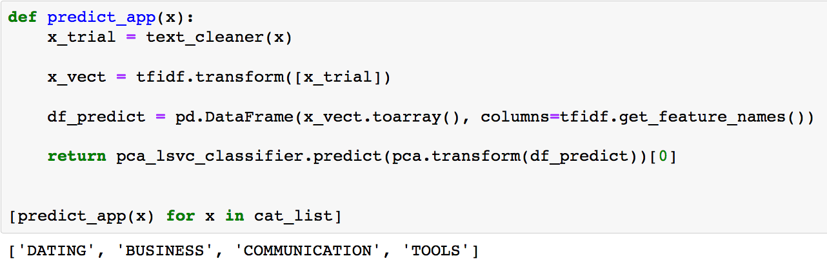
Predicting Categories Linear SVC Model

Slide 27
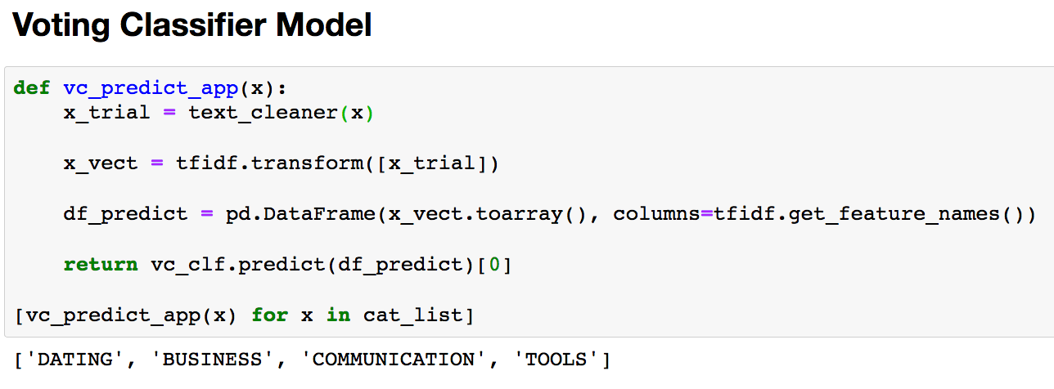
Predicting Categories Voting Classification Model

Slide 28
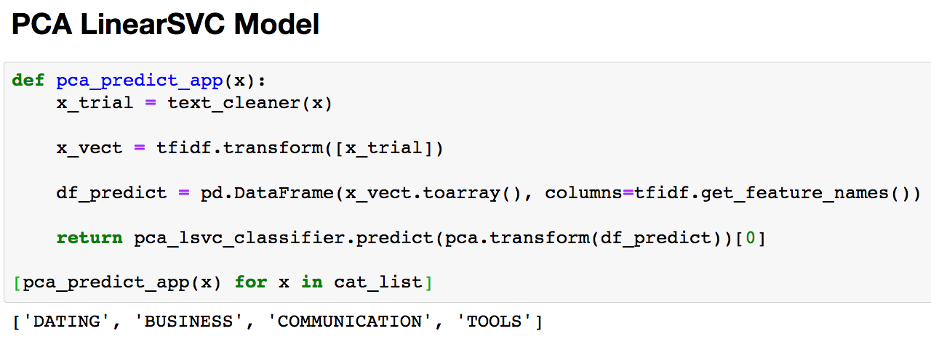
Predicting Categories PCA Linear SVC Model

Slide 29
Conclusion
Use Cases:
1. This can be a recommender for the Google Play Store or the Apple App Store when a developer is uploading their app.
2. An angel investor might double check the pitch of an app idea to see if it falls in the correct category
Potential Problems with our Models
We have 60 samples per category, this might not represent the distribution of download per applications in each category in the app store.
2. We only took descriptions from the top free apps of each category.

